Slide 1
BAD Presentation
Kevin O’ Donnell, Kevin McConomy, Callum Mclaughlin
Team PLAB

Slide 2
What is the aim of our project?
The aim of our project was to provide a written report as a Business Application Development team regarding the feasibility and system specification of our project, based on Desmond Motors.
Gain a deep understanding of the current system and its problems as well as designing a system that would eliminate as many inefficiencies as possible.
Develop a more refined understanding of the System Analysis and Design process by working in a small development team and taking on the role of Full Stack Developers.

Slide 3
What is our plans for the new system?
Improvements
Correct inefficiencies in the current system
Design
Create a user friendly and intuitive interface
Security
Implement a login system with hierarchical privileges.
Reports
Allow management to generate relevant reports E.g. weekly/monthly sales.
Search
Be able to search through the system for specific records about Customer , Cars etc.

Slide 4
About Desmond Motors
They are the largest ford dealership in Northern Ireland.
They supply roughly 50% of the ford cars and parts in Northern Ireland .
They provide New and used cars for people and Businesses .
They offer Finance plans and leases.
They offer valet , mot and Test Drive services.

Slide 5
Problems Identified in Business
Desmond's scheduling
The start of the project coincided with the start of a new quarter
Paper based system
All files are stored manually
More susceptible to loss, duplication & damage
Much slower and less efficient than a computerized system
No data analytics unless manually created
No links, no data integrity
Links must be manually created every time a record needs to be retrieved
Notes:
They started a new quarter during our project so we had to adjust our schedule around this.
The main problem with desmond was their almost entirely paper based system which had some computing elements but it wasn’t up to the same standard as other car dealerships. Their systems were not linked.

Slide 6
How we dealt with identified problems
Problems | Solutions
Project rejections (Walled City Vape, City Hotel) | Persisted investigating other businesses until our project was accepted by desmonds
Desmond Scheduling | Sent google forms to desmonds, allowing them to respond quickly and conveniently
Paper based system | Designed a computerized interface that is linked to a database, allowing storage of data.
No data integrity, no links between files. | Designed an integral database to handle all files and prevent data duplication.

Slide 7
Issues / Constraints moving forward
Rejection by walled city vape after 3 weeks of back and forth discussion
City hotel didn’t reply to our emails or respond to our enquiries over the phone.
We could never get a meeting with Eddie's Garage, and later decided that it was probably too small to base the project on.
Group scheduling presented problems on occasion because of other commitments.
Notes:
Rejection by walled city vape, city hotel ignoring us, garage being too small of a business, etc.

Slide 8

Main menu

Slide 9
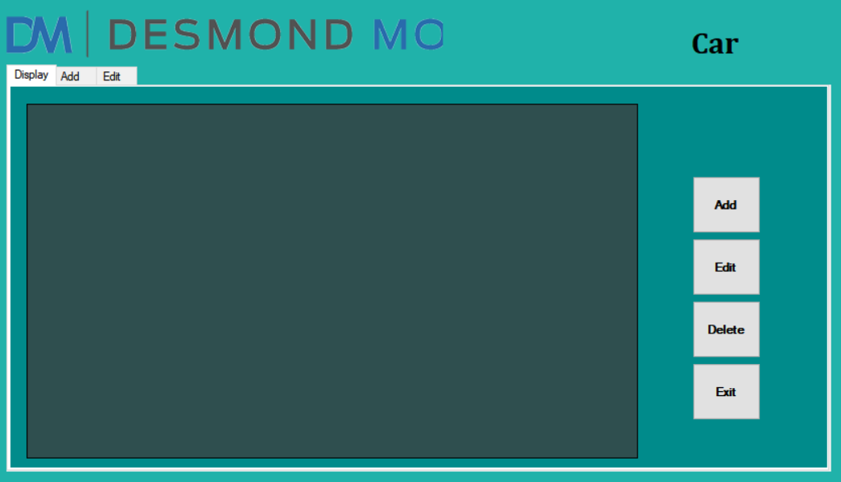
Car Form
Notes:
Screenshots of the forms goes in here, a few of the reports go in here too.

Slide 10
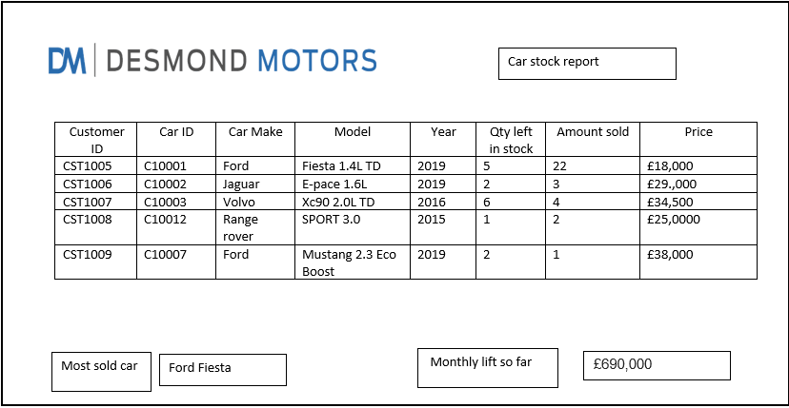
Car stock report
Notes:
Functional & non functional requirements can be summarised in here.

Slide 11
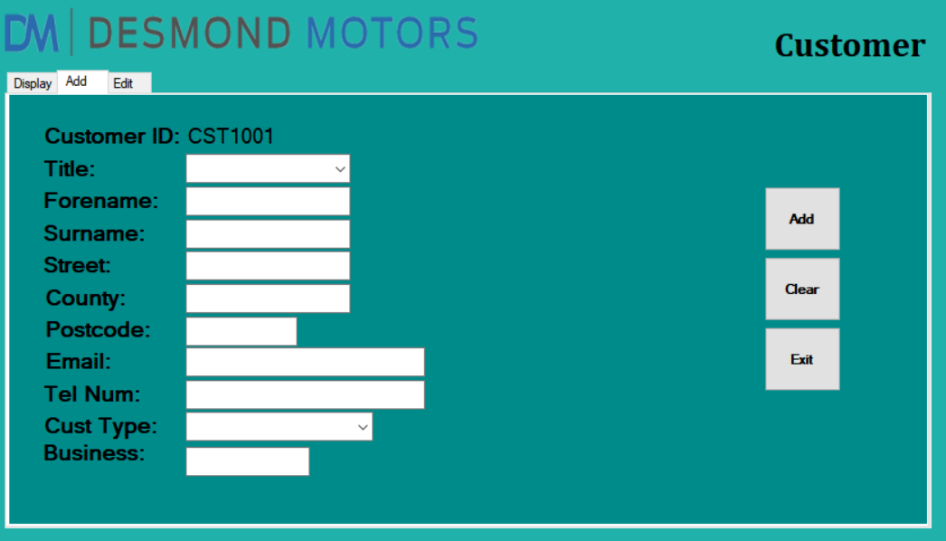
Customer form, Add tab

Slide 12
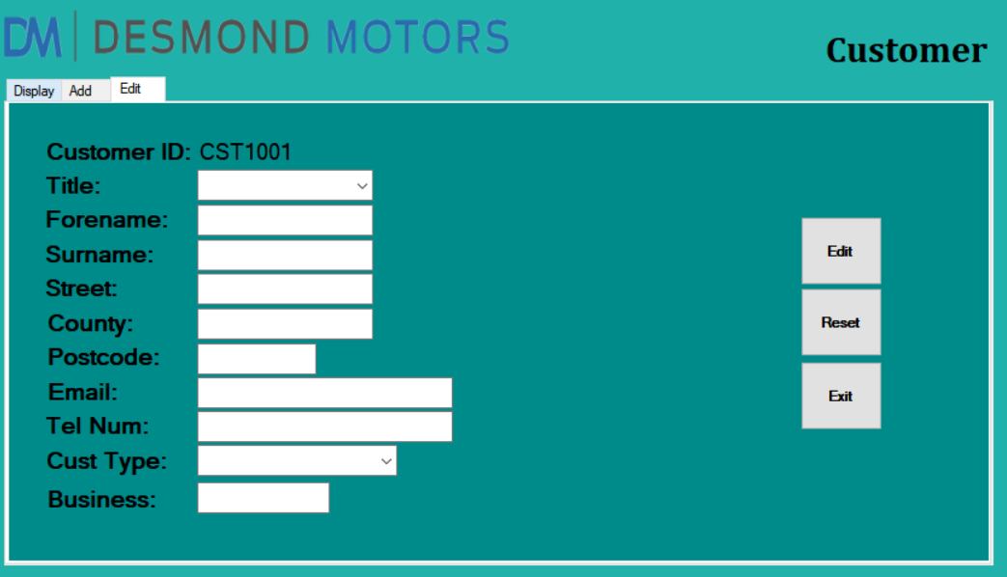
Customer form, Edit tab

Slide 13
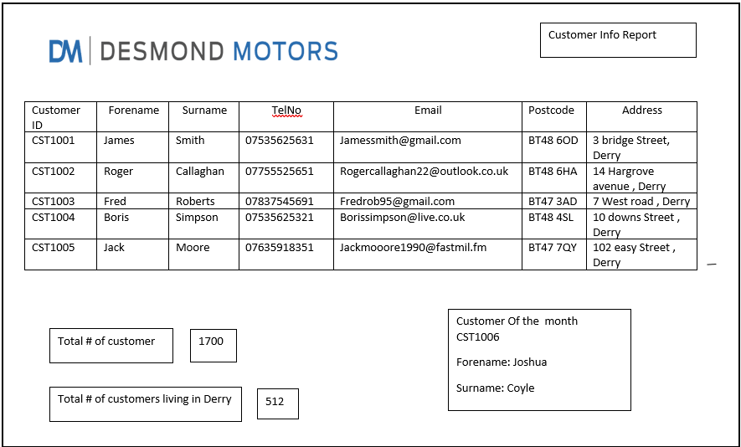
Customer info

Slide 14
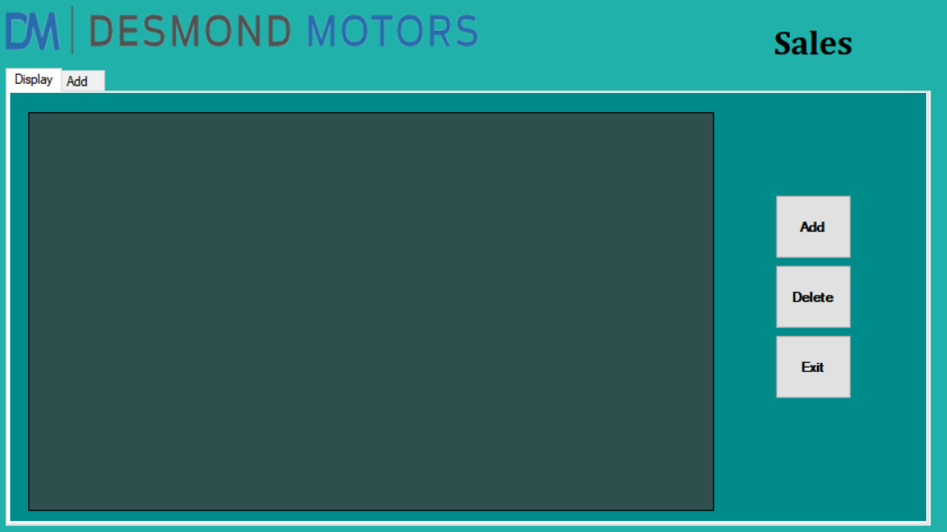
Sales form

Slide 15
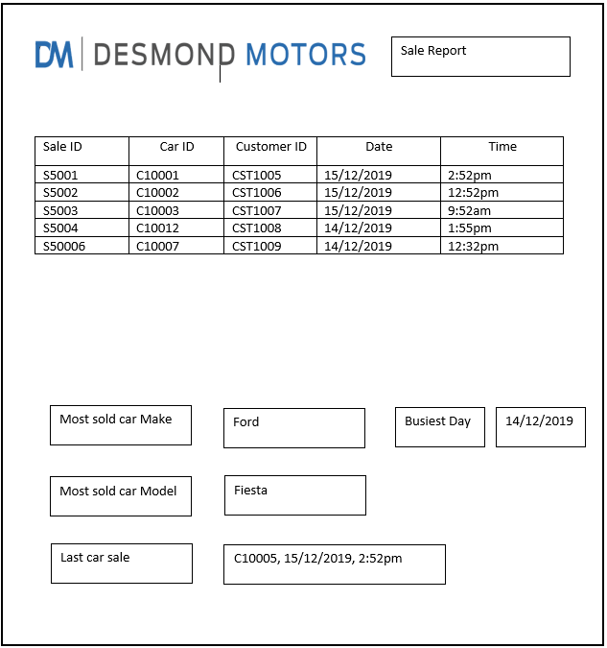
Sales report form

Slide 16

What have we achieved?
Full system specification starting from the initial analysis of the old system all the way through to the design of the new system using the waterfall methodology
Created data flow diagrams detailing the current business processes and files, as well as the processes and files for the new system e.g. changing all the manual stores to data stores.
Gained invaluable experience in working through the software development lifecycle as a team.

Slide 17

What have we learned from this project?
How to effectively apply the Software Development Life Cycle and its principles to a real project, meeting deadlines and producing relevant documentation.
How to diligently divide work between members of the group and complete it to a professional standard.
The importance of succinct communication within the group.
How the use of a project plan is crucial to the success of the project.

Slide 18

What would we do differently?
Manage our time more effectively
Organize team meetings more regularly
Be more proactive in finding businesses earlier
Update our task log on a more consistent basis
Get more detail of the current system

Slide 19
Questions

